Slide 1
Final Presentation
New York University Tandon School of Engineering
MG-GY 8411 Data Engineering
Carlos De Oliveira
Yunjie Yang

Slide 2
Description
These codes consist of 3 main parts.
Part 1: Download the first 10 hours of real-time data.
Part 2: Train regression models based on the first 10 hours of data and test it using 1 hour of data.
Part 3: Download new 10-hour real-time data with predicted values, etc.

Slide 3
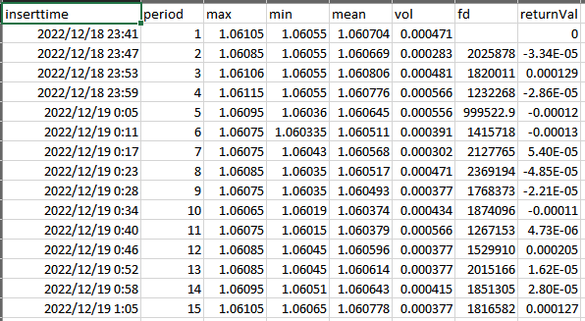
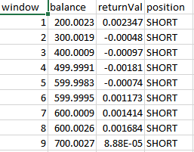
First 10 hours of data
The first 10 hours of real-time data included 2 types of tables. The data stored in the final.db.
curr[0]curr[1]_agg.csv
curr[0]curr[1]_output.csv
EURUSD_agg
USDNZD_output

Slide 4
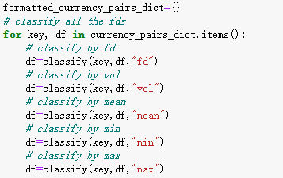
Train regression model
The first 10 hours of real-time data (curr[0]curr[1]_agg) was used to train regression model.
Feature: fd, vol, mean, min, max
Value: return_predict

Slide 5
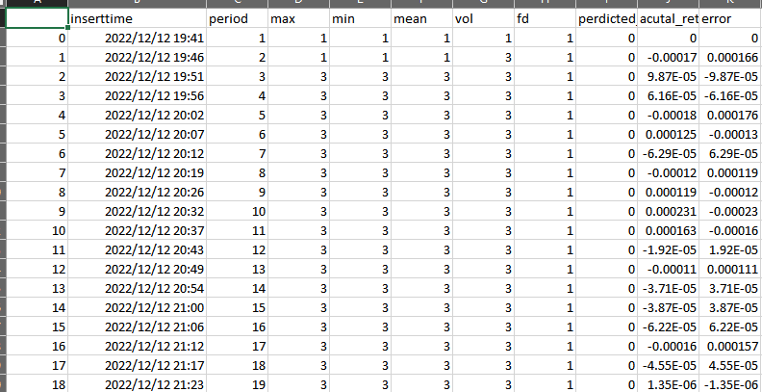
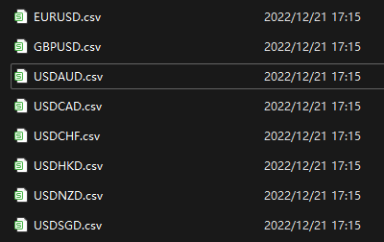
Test regression model
Using 1 hour of real-time data (curr[0]curr[1]_agg) to test the regression model.
curr[0]curr[1].csv is the new table with predict_return and error.

Slide 6
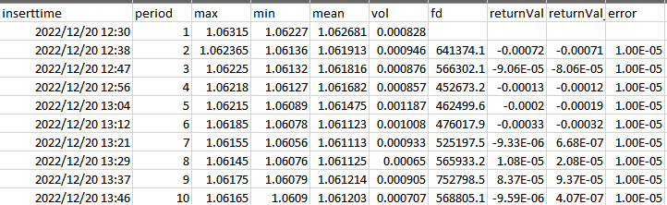
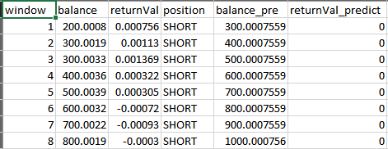
Predict next 10 hours
Download next 10 hours of real-time data with predict_return and error. The data stored in the final1.db.
curr[0]curr[1]_agg_predict_10hour.csv
curr[0]curr[1]_output_predict_10hour.csv
EURUSD_agg_predict_10hour.csv
GBPUSD_output_predict_10hour.csv

